Slide 1
For teachers
Please show this presentation in slide show mode
Show ‘Default Section’ for both CC1 and CC2
Use the section that relates to the course you are teaching.
  If it is CC1, please only show the required slides and CC1 section
  If it is CC2, please only show the required slides and CC2 section

Slide 2

Welcome to
Childcare

Slide 3
Agenda
Important People
Requirements to pass the class
Class Overview

Slide 4

Important People
Your teachers
Ashley Iraheta
Education Coordinator
Shakib Mahmud
Notes:
Your teachers are Christina Shutes and Patti Kaiser.
Ashley Iraheta will send codes to complete trainings, and you will send her your training certificates by the end of the course in order to receive your certificate of completion for the class

Slide 5
Requirements to Pass the Class
75% Attendance
Complete all Better Kid Care trainings
Complete American Red Cross First Aid/CPR/AED Training (CC1)
Attend at least one job skills workshop

Slide 6
Class Overview
This class is for students who are interested in learning more about children and working in childcare settings. In this class, you will improve your English skills and learn about communicating with parents, communicating with children, health, and safety. You will learn about first aid and CPR/AED and earn your American Red Cross certification.

Slide 7
Class Details
Mondays and Wednesdays
7:30pm – 09:30pm
Reminders:
Please join the class no later than 7:30pm
Please have your cameras on during the class
Do not schedule anything else during this time
Contact Ashley if you cannot attend class

Slide 8
Google Translate
Notes:
Start video once “Everything is in English” has finished for audio to be in sync.

Slide 9

Required Materials
In addition to an account with Better Kid Care, you have a textbook

Slide 10
Required Materials – Parts of the Book
Chapter 1: Welcome
Chapter 2: Communicating About Childcare
Chapter 3: Book Report
Chapter 4: Preventing Accidents
Chapter 5: Reporting Incidents

Slide 11
Parts of the Textbook
Vocabulary
English words related to childcare and parenting; before and after each reading;
Reading
Presents the topic and is relevant to getting started with childcare, health and safety, or stages of child development.

Slide 12
Parts of the Textbook
Discussion
Process with classmates what you learned in the reading; gain new perspective
Listening and Speaking
Practice oral communication; practice typical conversations of parents, teachers, childcare providers
Dialogs / Information gap communication / Voicemail messages / Role-play

Slide 13
Parts of the Textbook
Grammar
Practice grammar structures in oral and written form
Writing
Practice written communication for child care providers, teachers, or parents
Group Interaction
Build skills and create community with classmates

Slide 14
Parts of the Textbook
Language Focus
Aspects of the English language are explained in boxes next to learning activities
Functional language patterns / Grammar and syntax / Pronunciation and intonation / Vocabulary and expressions
Cultural Note
American-made choices/attitudes about parenting, children, child care presented for discussion

Slide 15
Parts of the Textbook
Dictation
Supports comprehension, word recognition, and spelling; connects spoken and written language
Songs, games, nursery games
Contribute to children’s skill development and self-confidence; goes along with theme of chapter
Putting it all together
See how everything you learned in the chapter comes together

Slide 16
Parts of the Textbook
Library corner
Familiarize yourself with resources to help make reding fun and important to children
Discussion about books and reading / Library action tasks / Suggested books based on themes and children’s ages
Extension Activities
Helps prepare caregivers to promote language learning and literacy among children

Slide 17
Virginia Department of Social Services’ Child Abuse and Neglect Training

Slide 18
Better Kid Care by Penn State
How to Find Trainings

Slide 19
Better Kid Care by Penn State
How to find the required VA Trainings

Slide 20
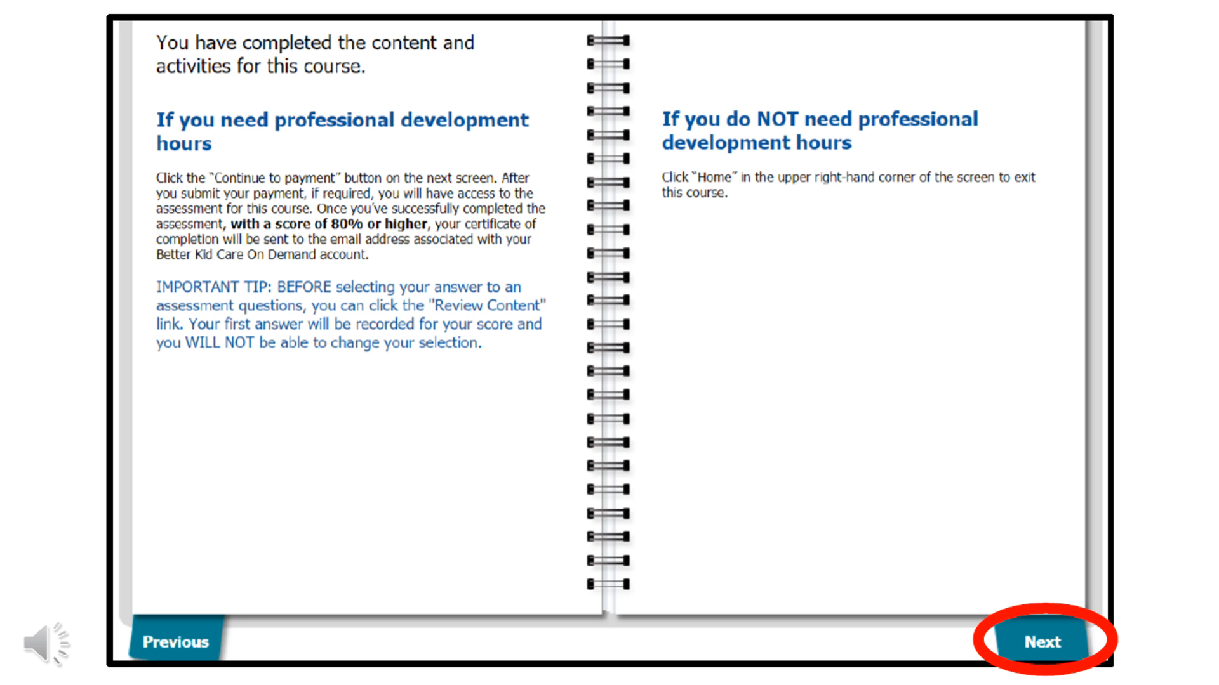

Better Kid Care by Penn State
How to Finish a Training

Slide 21
Required Trainings
All students must complete the following trainings:
Virginia Department of Social Services’ Child Abuse and Neglect Training
Virginia Preservice Training for Childcare Staff
Virginia Annual Health and Safety Update Training for Childcare Staff (2024)
American Red Cross Adult & Pediatric First Aid/CPR/AED Certification (in-person)
Communicate Effectively With Children
911: Responding to Medical Emergencies
A Good Night’s Sleep: How Sleep Affects Health
Child Development: An Introduction to Learning Theories

Slide 22
Required Trainings for Specific Concentrations
Infants/Toddlers | Preschoolers | School-Age
Safe Sleep Practices for Caregivers: Reduce the Risk of SUID | Preschool Foundations: Environments and Routines that Work! | Food Allergies: Management and Prevention
Infant-Toddler Care: Quality Supervision | Family Childcare: Support Preschoolers | Supervision: What’s Required?
Infant-Toddler Care: Safety | Resilient Caregivers: 'Bouncing Back' from Stress | Supervision: Staff: Child Ratios

Slide 23
Required Trainings
By the end of the semester, you should have completed 34 hours of training:
VDSS Child Abuse and Neglect Training – 1 hour
American Red Cross First Aid/CPR Training – 4 hours
Required Better Kid Care Trainings – 19 hours
Specific Trainings BKC for concentrations – 9 hours

Slide 24
CDA – What is it?
The Child Development Associate (CDA) Credential is a national credential issued by the Council for Professional Recognition.
Requirements to obtain depend on concentration:
Center-Based Infant-Toddler
Center-Based Preschool
Family Child Care
Home Visitor
Military School-Age (MSA)

Slide 25
CDA – Better Kid Care
See how Better Kid Care can help you earn your CDA
Catholic Charities does NOT pay for you to earn CDA. This is something you would have to do yourself.

Slide 26
Happy learning!

Slide 27
Congratulations!
You have completed Childcare 1

Slide 28
What you have done…
Completed 30 hours of training through BKC
Received your Adult & Pediatric First Aid/CPR/AED Training through American Red Cross
Learned how to communicate with parents, prevent accidents, report incidents, and treat common illnesses and injuries.

Slide 29
What happens next?
Childcare 2
If your goal is to get your CDA, Better Kid Care can help!
  As a reminder, CCDA does not pay for these courses or anything CDA related

Slide 30
Class Details
Mondays and Wednesdays
07:30pm – 09:30pm

Slide 31
Required Trainings for Infants/Toddlers
Creating Special Moments with Infants and Toddlers | Infant-Toddler Care: Learning through Play
Early Intervention (EI): An Introduction | Infant-Toddler Care: Partnerships with Families
Early Intervention: Support Infants and Toddlers | Infant-Toddler Care: Physical and Cognitive Development
How to Work with Active Children | Infant-Toddler Care: Sensitive, Nurturing Professionals Needed
Infant-Toddler Care: Daily Routines | Rock Solid: Building Positive Relationships, Birth – 3 years, Part 2
Infant-Toddler Care: Emotional and Social Development | Rock Solid: Enhancing Emotional Literacy: Birth – Age Three
Infant-Toddler Care: Guiding Behavior | Taking Steps to Healthy Success: Breastfeeding Support
Infant-Toddler Care: Language and Literacy | Transition Plans, Practices, and Approaches: Pathways to Success
 | Understanding Toddlers

Slide 32
Required Trainings for Preschoolers
Adverse Childhood Experiences: Building Resilience | Preschool Foundations: Effective Partnerships with Families
Community-Based Services: Connect Families | Preschool Foundations: Nurture Interactions and Guide Behavior
Cultural Understanding: Building Solid Foundations | Preschool Foundations: Observe, Document, and Assess
Easy Ways to Boost Children's Brain Power | Preschool Foundations: Understand Physical and Cognitive Development
Effective Practices to Promote Healthy Eating in ECE | Problem-Solving Approaches to Use Everyday
Engage Families and Build Relationships | Rock Solid: Enhancing Emotional Literacy: Birth – Age Three
Executive Function Skills: Foster with Play | School Readiness: Lay the Foundation in the Early Years
Preschoolers' Emotional Development: Feelings and Managing Emotions | STEAM for the Preschool Programming Engine
 | The Ins and Outs of Good Circle Times

Slide 33
Required Trainings for School-Age
Adverse Childhood Experiences: Building Resilience | School-Age Youth Programs: Commit to Quality and Lifelong Learning
Building Relationships with Children and Youth Who Challenge Us | School-Age Youth Programs: Health and Safety Best Practices
Career Preparation in Out-of-School Time Programs | School-Age Youth Programs: Learning Plans that Work
Communicating with Children | School-Age Youth Programs: Learning Spaces that Work
Dealing with Anger – The Children's and Yours | School-Age Youth Programs: Positive Interactions, Positive Outcomes
Get Outdoors. Explore. | Stress: Seeing with Optimism
Keeping Families Engaged Through the School-Age Years | Supervision: Counting Children
Positive Youth Development: Building a Culture of Belonging | Supporting Historically Marginalized Youth in STEM
 | Tools of the Trade for School-Age Practitioners: Positive Guidance

Slide 34

Textbook
Sections 1 and 2
(Chapters 1-5)

Slide 35
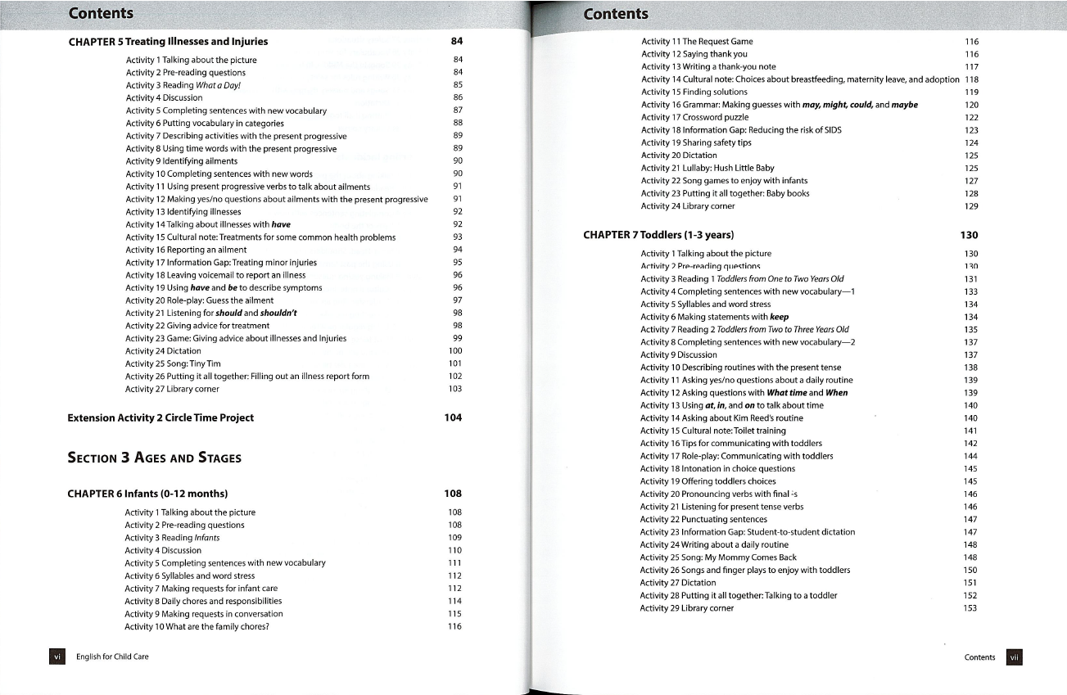
Textbook
Table of Contents

Slide 36
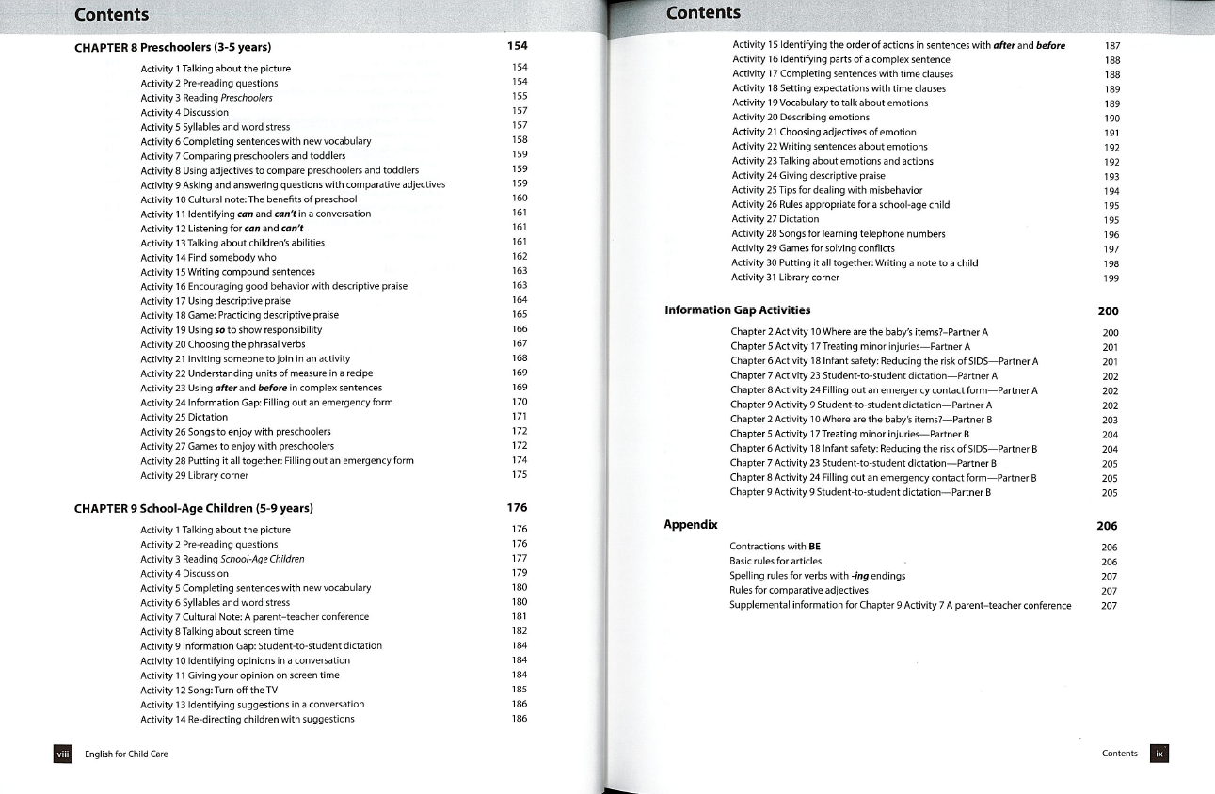
Textbook

Slide 37
Congratulations!
You have completed Childcare 2

Slide 38
Important People
Shakib Mahmud – Education Coordinator
Send certificates
Ask for codes
Communication
Ashley Iraheta - Teacher
Class
Questions

Slide 39
What you have done…
Completed 34 more hours of training through Better Kid Care
Learned how to support the developmental needs of infants, toddlers, preschoolers, and school age children
Notes:
Be sure all certifications have been sent to the Workforce Development Coordinator (Ashley Iraheta)

Slide 40
What happens next?
CDA
  Better Kid Care
  Employer
  Community College
Employment
  Childcare Center Worker
  Paraprofessional
  Aide
  Before and After-School Program Worker
  RBT – Registered Behavior Technician
Notes:
CDA
You can receive your CDA by completing trainings on Better Kid Care, paid by you.
You could also find an employer that is willing to pay for professional development so you can receive your CDA
You could enroll in a college course to get your CDA training
Employment Options
Childcare Center Worker - attend to children's basic needs like feeding them, preparing meals, changing diapers, and supervising playtime and activities. They are also expected to assist with lesson planning, maintain a clean and safe environment and communicate with families.
At least 18 years of age with a high school diploma or GED.
Pass required state and company background checks.
At least six months of experience working with children in a professional setting.
Early childhood coursework, CDA, or degree preferred
Paraprofessional - an extra teacher in the classroom, helping students that require personalized support reach their personal and educational goals.
at least 18 years of age (21 years of age preferred)
high school diploma or General Educational Development (GED) certificate
have two years of work experience with children or completed two years of coursework in a related field
Passed criminal background check.
Passed abuse registry check.
Aide - Provides support to the teacher to ensure a safe and stimulating educational environment. Assists the teacher in planning and preparation for daily activities; aids instructional efforts of the teacher. Assists the teacher in preparing lesson outlines, plans, and curricula in assigned areas.
At least a high school diploma, though many states require some college education
Certifications, such as CPR or first aid certifications
Passing scores on a skills exam, particularly for those working with special needs students
Passed criminal background check.
Passed abuse registry check.
Before and After School Program Worker - responsible for helping out with activities, games, crafts, and homework for participants in the program.
High school diploma
One year working with children
Passed criminal background check.
Passed abuse registry check.
Registered Behavior Technician - a paraprofessional who works one-on-one or in small groups with clients and their families dealing with learning behavioral challenges.
18(+) years old with a high school education or equivalent.
Passed criminal background check.
Passed abuse registry check.
Completion of a 40-hour training course*
Successfully complete an RBT initial competency assessment.
Approved application from BACB (Behavior Analyst Certification Board)

Slide 41
CDA – Child Development Associate
High school diploma or GED
Complete 120 hours of training
Obtain 480 hours of work experience
Prepare a professional portfolio
Complete an application
Pass an exam
Schedule and engage in a verification visit
Notes:
CDA
You can receive your CDA by completing trainings on Better Kid Care, paid by you.
You could also find an employer that is willing to pay for professional development so you can receive your CDA
You could enroll in a community college to

